Slide 1
Neutrinos in Nuclear Physics
BJPJ

Slide 2
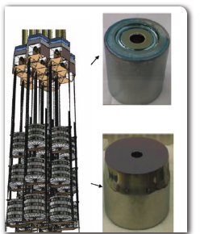
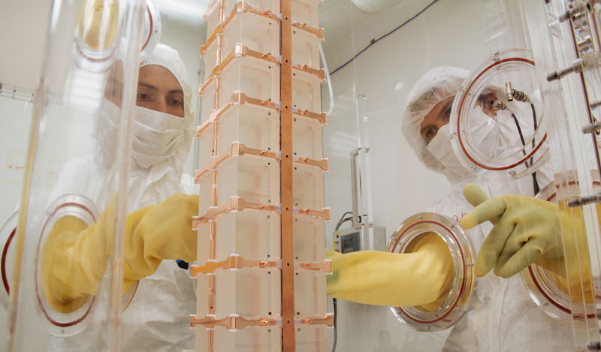
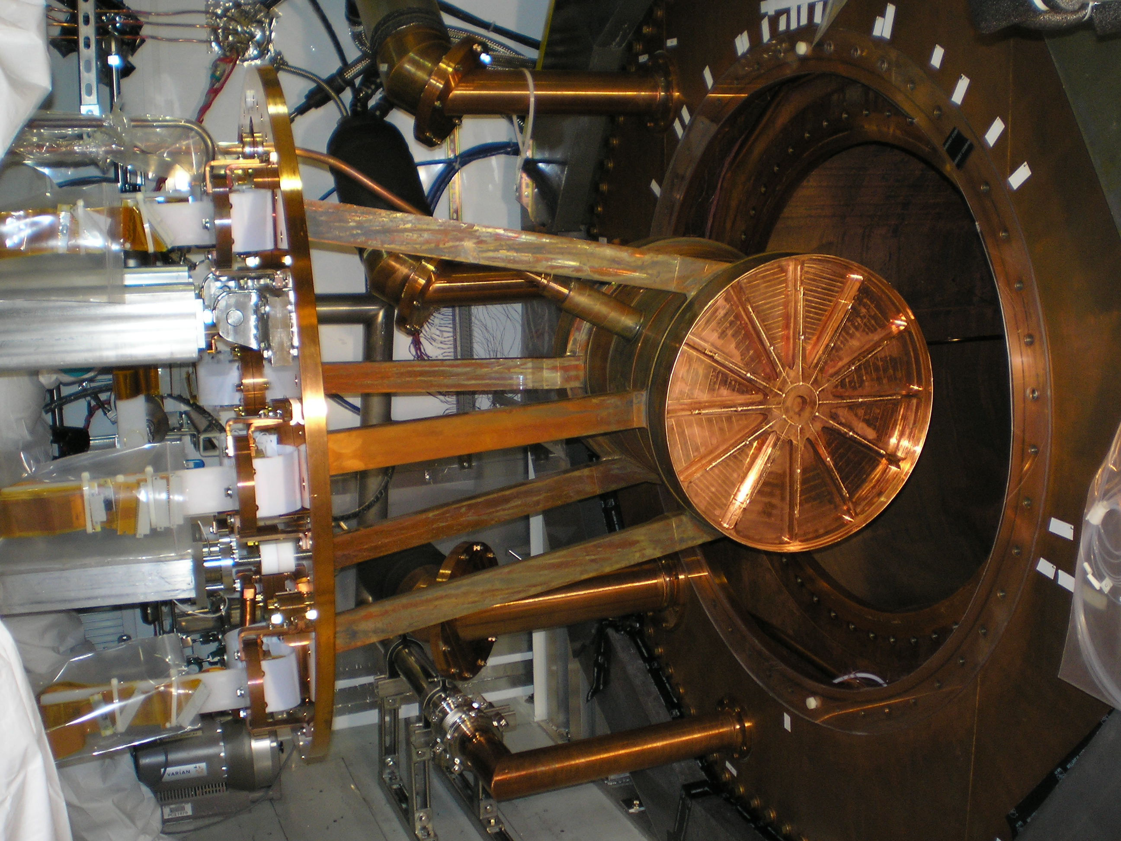
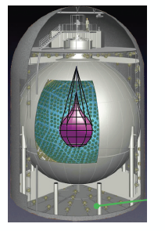
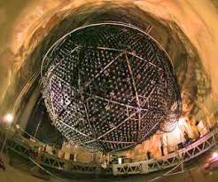
The zoo of 0nubb searches
CUORE/CUPID
Many completely different technologies…
GERDA/MAJORANA/
Legend
EXO/nEXO
Kamland Zen
SNO+

Slide 3
The zoo of 0nubb searches
CUORE/CUPID
Many completely different technologies…
GERDA/MAJORANA/
Legend
This lecture, like life, is too short.
Instead, try to explain the physics that connects them all
EXO/nEXO
Kamland Zen
SNO+

Slide 4
RELATIVISTIC QUANTUM
MECHANICS

Slide 5
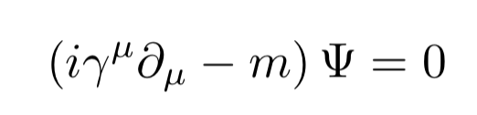
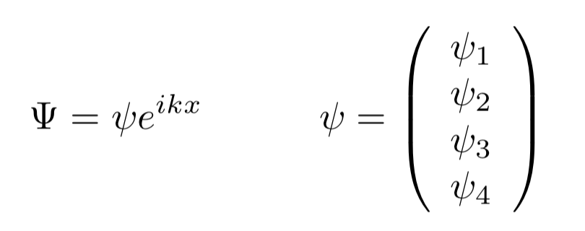
Dirac Equation
Spin ½ fermions satisfy an equation of motion called the Dirac equation:
The Schrodinger Eq. of relativistic spin ½ fermions
The solution can be written as an object with four components called a Dirac spinor:
How much of this kind of particle is where
Paul Dirac
???

Slide 6
What do the four degrees of freedom of the Dirac spinor mean?
With a judicious choice of basis (Weyl):
Dirac spinor breaks into two components for a spin-up particle and two components for a spin-down particle.
But why are there two kinds of field for each spin?
Two left spinning things
Two right spinning things
(when relativistic)

Slide 7
Antimatter
Each pair has a positive energy part and a negative energy part.
The negative energy part represents antimatter.
  Matter moving backward in time, according to the Feynman Stueckelberg interpretation.
  Ψ= Ψ₀e^{-i E t / ℏ}
The positron is the electrons antiparticle. It was predicted by Dirac (1928) before it was discovered by Anderson (1932).
First positron detection, 1932

Slide 8
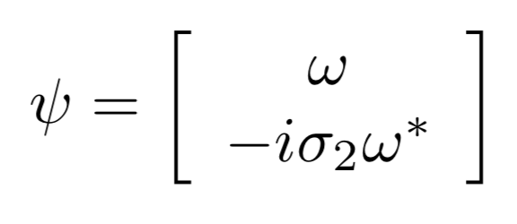
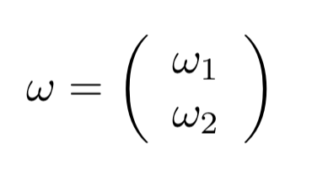
NOT SO FAST!
Four numbers at each point in space? I’ll do it with two!
But, Ettore Majorana found a new class of solutions to Dirac’s equation using only two degrees of freedom.
Four-component object built using some two-component ⍵(x)
Ettore Majorana

Slide 9



Charge Conjugation
Definition of charge conjugation operation:
transform particles ←→ antiparticles
For Majorana’s solution:
Whereas for a general Dirac solution:
It’s antiparticle is the particle!
Two degrees of freedom correspond to
left and right of a “particle-antiparticle-thing”
Distinct particle and antiparticle
Four degrees of freedom correspond to
left and right of particle and antiparticle.

Slide 10
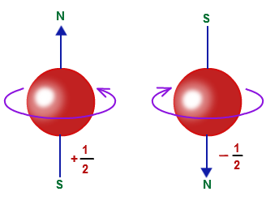
In short, what are Majorana fermions:
We call it a particle
(behaves like matter)
We call it an antiparticle
(behaves like antimatter)

Slide 11
Who cares?

Slide 12
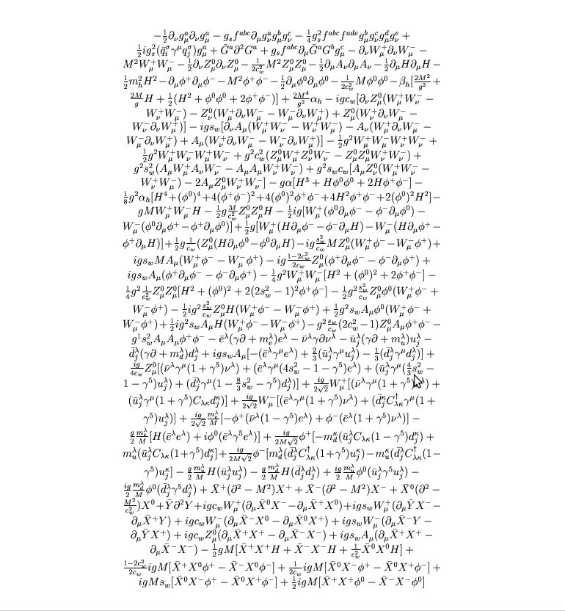
The standard model Lagrangian
Each term represents some interaction between quantum fields.
After quantizing the theory, this becomes an interaction between particles.

Slide 13
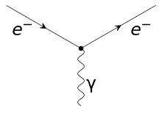

Slide 14
Mercifully, there is a recipe for writing down that Lagrangian.
Write down all terms that are:
1) Consistent with the symmetries of nature
2) Renormalizible
Gauge invariance:
+ Lorentz invariance
  All appear in nature, except 1 mystery absentee (strong CPV).

Slide 15
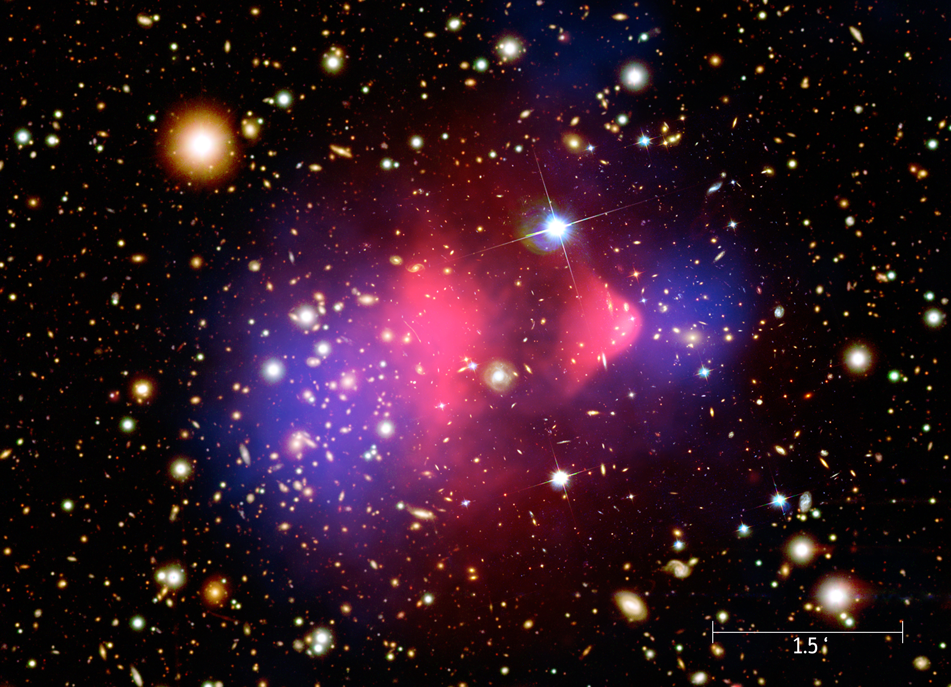
Is there more?
We’ve never seen a particle interaction not predicted by the SM. But we suspect there is new physics out there…
  Dark matter
  Hierarchy problem
  Gauge unification
  Etc…
Lots of ideas:
  SUSY
  Extra dimensions
  String theory
  Lorentz violation
  [your favorite theory]
Evidence for dark matter from gravitational lensing

Slide 16
We believe that whatever the new physics is, it kicks in a high energies (that’s why we build accelerators).
Technically we say the SM is likely a “low energy effective theory”.
At high energies:
COMPLETE THEORY, VALID AT ALL ENERGIES
At low energies:

Slide 17
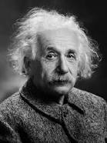
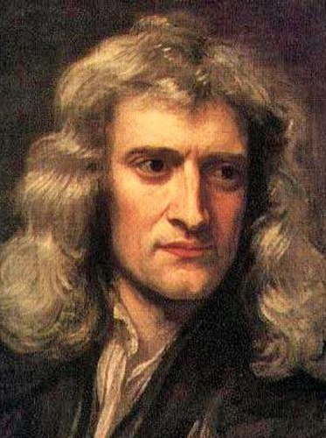
As a point of reference, here is another low energy effective theory:
At high energies:
At low energies:

Slide 18
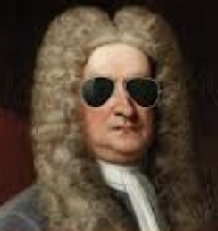
As a point of reference, here is another low energy effective theory:
At high energies:
At low energies:
“dimension-4 correction”
And, we can test the high energy theory by confirming these corrections.

Slide 19
If SM is a low energy effective theory:
Standard model
Dimension-5 terms
Dimension-6 terms
Etc…
E_{new} > 10 TeV Seems likely (LHC)
E_{new} ~ 10¹³ TeV Maybe? (GUT scale)

Slide 20
If SM is a low energy effective theory:
The only dimension-5 operator one can add obeying SM gauge symmetry:
This term does an important thing - it makes neutrinos Majorana particles, with mass suppressed by the new physics scale.
And it makes the theory non-renormalizible – implying there must be something else at high scale.
Weinberg 1979.

Slide 21
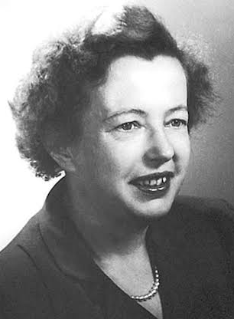
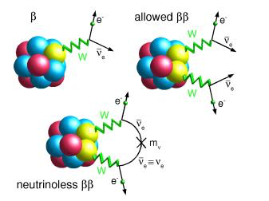
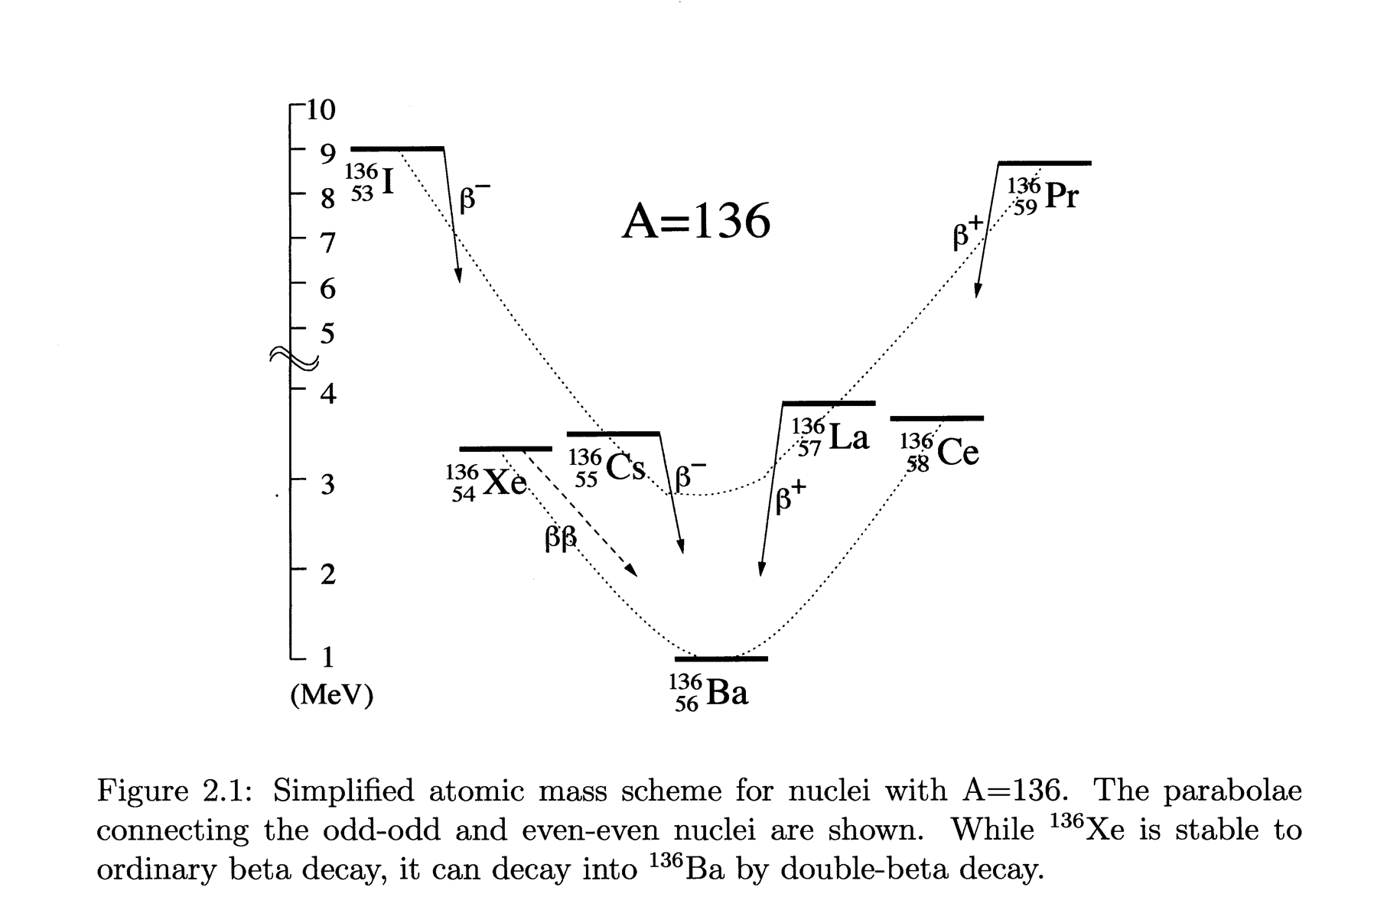
Double-Beta Decay
  A rare radioactive process, energetically allowed for some even-even nuclei where m_{Z+1} > m_{Z} > m_{Z+2}
(Z,A) → (Z+2,A) + e⁻₁ + ν₁ + e⁻₂ + ν₂
Maria Goeppert Mayer
(NB: this decay mode has nothing to do with Majorana neutrinos, but we’ll get back to them soon)
Notes:
Parabolae connect odd-odd and even-even nuclei are shown; pairing energy lifts odd-even above even-even Z – N;
Calculation of matrix elements have to include contributions of all virtual intermediate excited states.

Slide 22
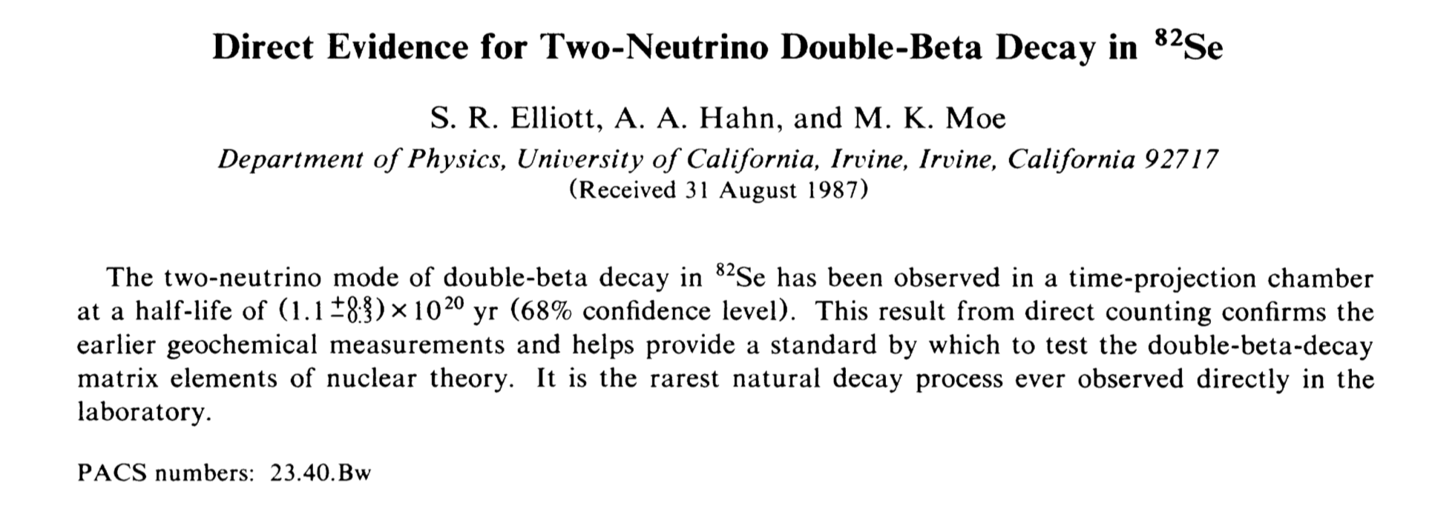
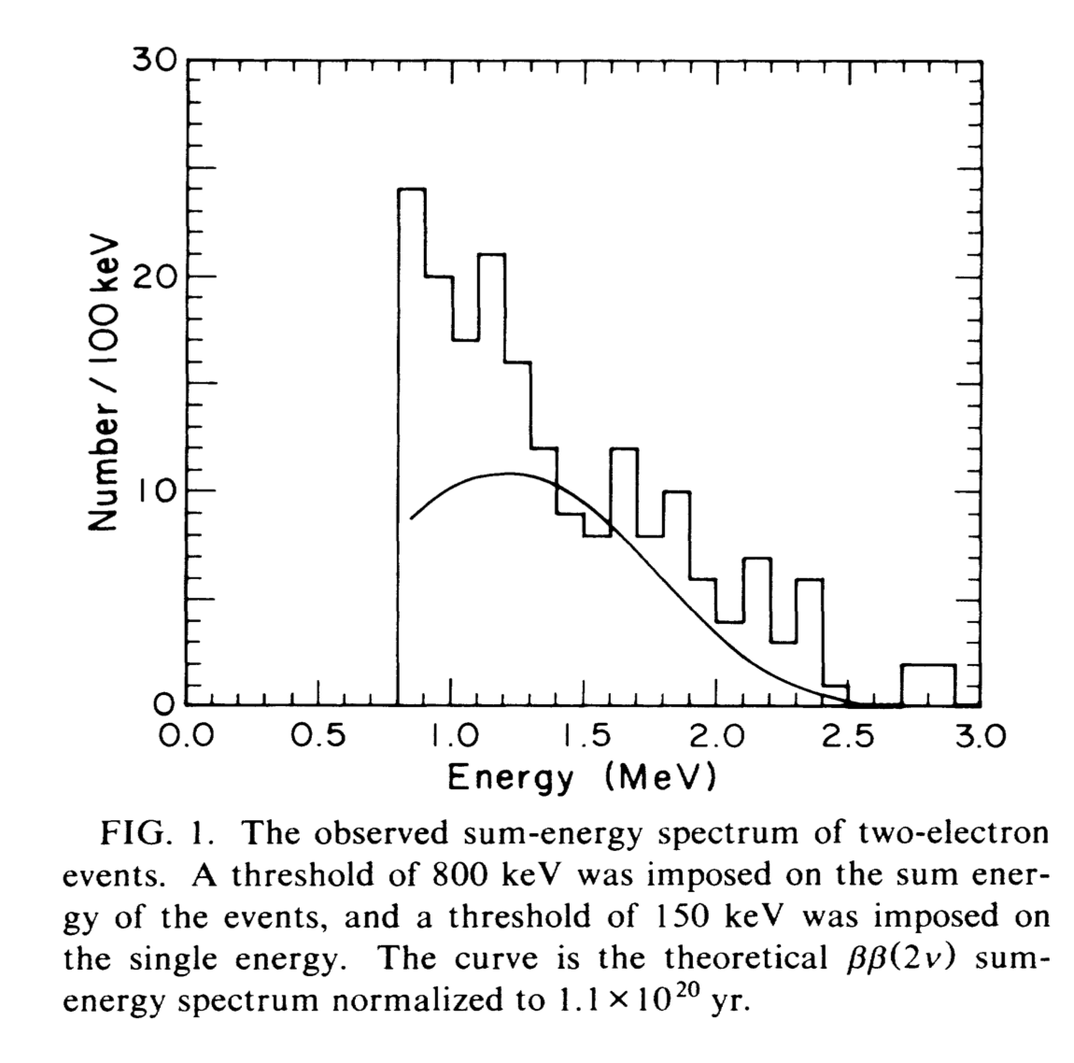
Discovery of double beta decay
Observed in ⁸²Se, 52 years after prediction.
Half-life is ~10¹³ times age of Universe.

Slide 23
Double beta with no neutrinos?
This can only happen if the neutrino is its own antiparticle.
Observation of double beta decay with no neutrinos would prove the neutrino to be a Majorana fermion.
How fast will this decay go? Lets find out!

Slide 24
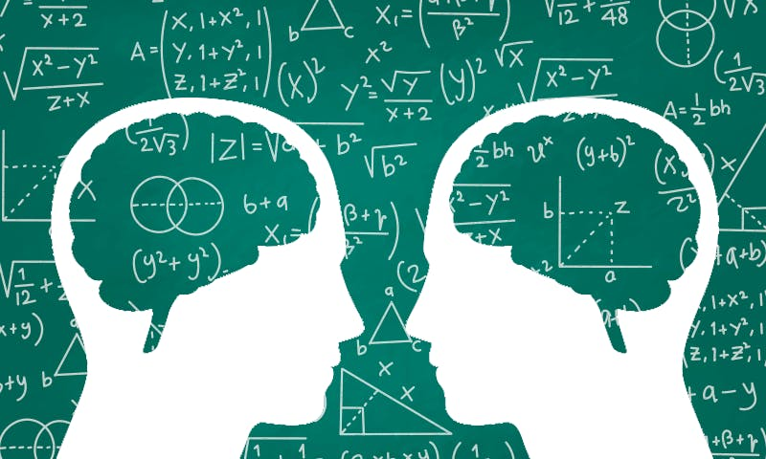
TIME FOR MATH INTERLUDE 2

Slide 25
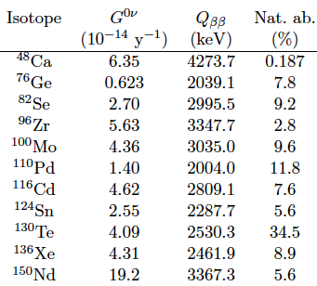
Double Beta Isotopes
Natural abundance
Energy of peak
Phase space factor
Larger G → higher rate
Helps if Q is above most background γ rays
Abundance, cost, and ease of enrichment are also factors influencing isotope choice.

Slide 26
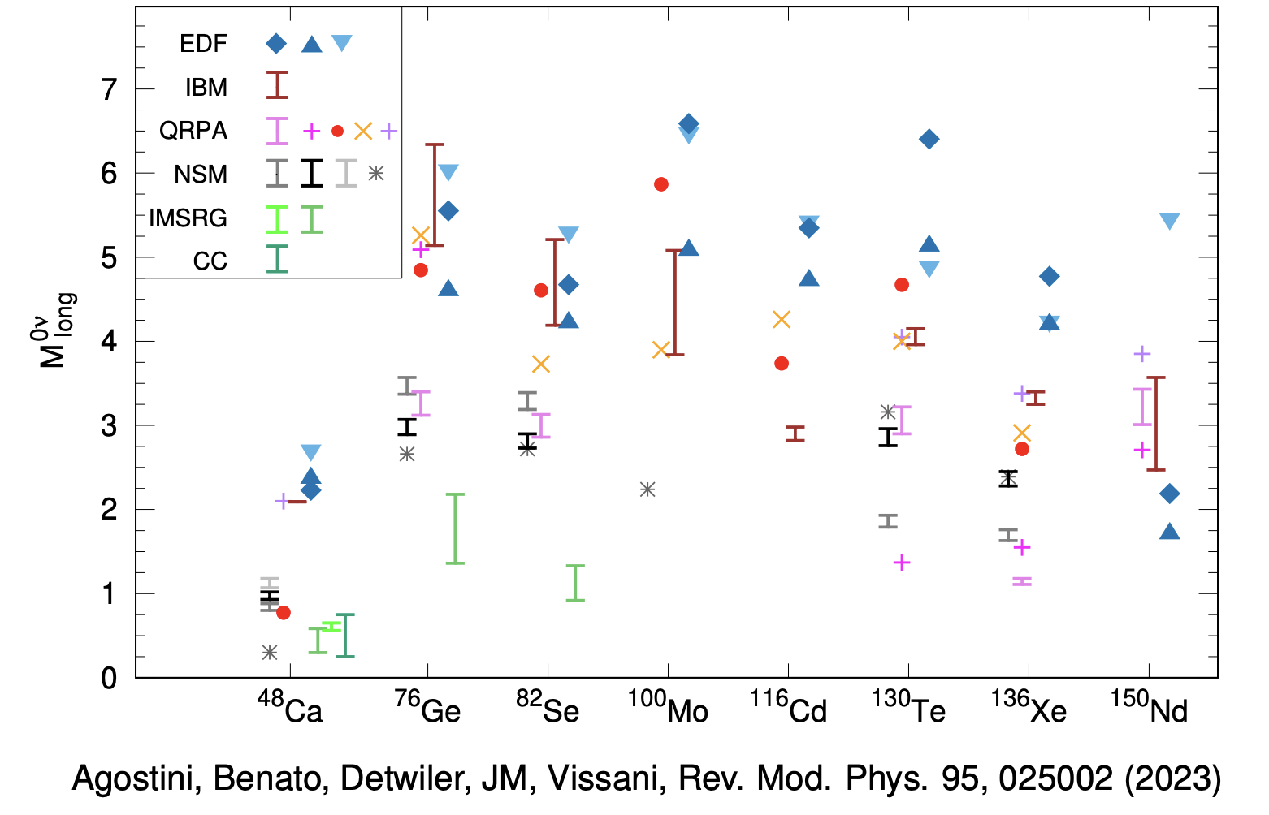
Nuclear matrix elements

Slide 27
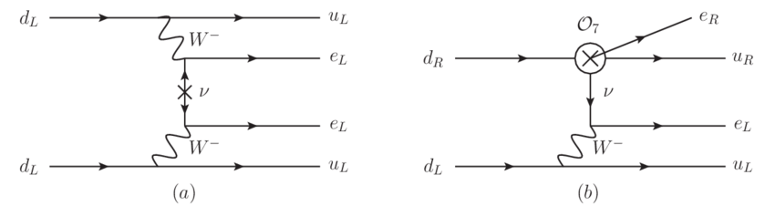
2
Γ ⍺
+
+
1
2
3

Slide 28
2
Γ ⍺
+
+
1
2
3
2
=
(U_{e1})²m₁
+
(U_{e2})²m₂
+
(U_{e3})²m₃

Slide 29
2
Γ ⍺
+
+
1
2
3
2
=
(U_{e1})²m₁
+
(U_{e2})²m₂
+
(U_{e3})²m₃
2
=
c₁₂²c₁₃²e^{2i⍺} m₁
+
c₁₂²s₁₂²e^{2iβ} m₂
+
s₁₃²m₃

Slide 30
2
Γ ⍺
+
+
1
2
3
2
=
(U_{e1})²m₁
+
(U_{e2})²m₂
+
(U_{e3})²m₃
2
=
c₁₂²c₁₃²e^{2i⍺} m₁
+
c₁₂²s₁₂²e^{2iβ} m₂
+
s₁₃²m₃
2
=
m_{ββ}

Slide 31
2
Γ ⍺
+
+
1
2
3
Im(M)
Normal Ordering
Im(M)
Inverted Ordering
(angles are unknown CP phases)
(angles are unknown CP phases)
Re(M)
Re(M)

Slide 32
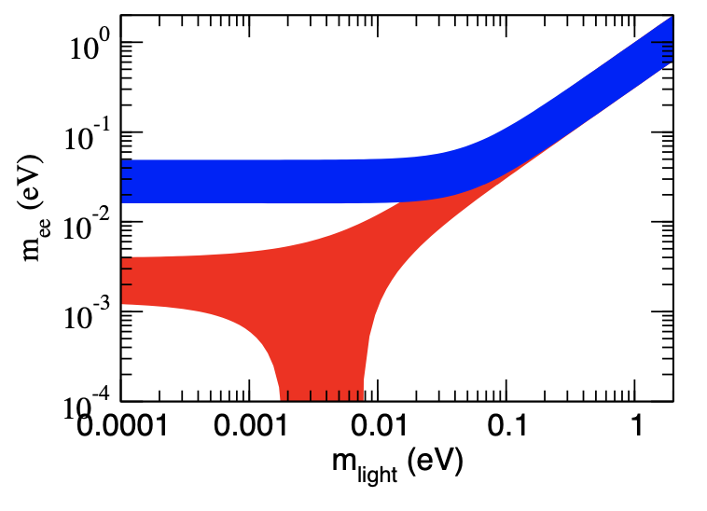
Inverted
Normal

Slide 33
What if there are additional neutrinos?
2
Γ ⍺
+
+
+
1
2
3
4
Im(M)
IO, 3 neutrinos
Im(M)
IO, 4 neutrinos
(angles are unknown CP phases)
(angles are unknown CP phases)
Re(M)
Re(M)

Slide 34
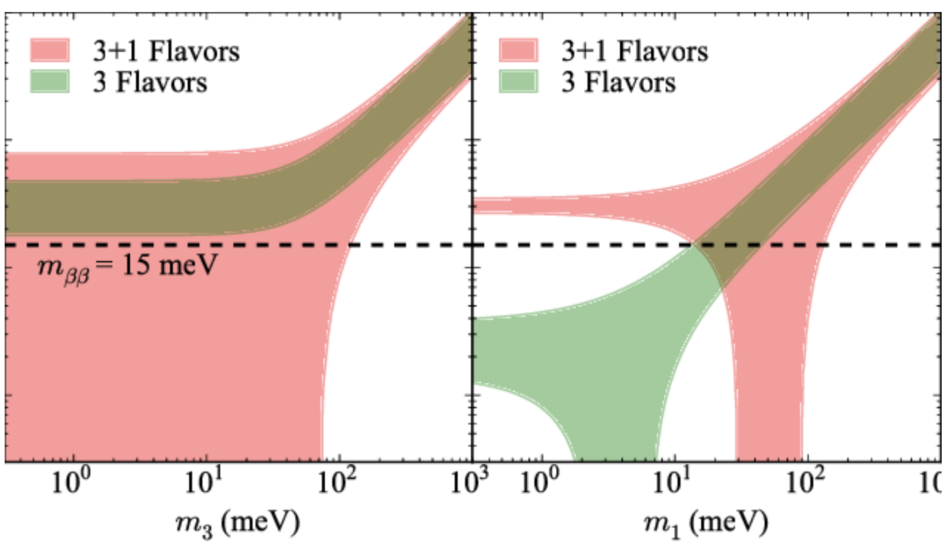
With a sterile neutrino:
Inverted
Normal
m_{ββ}
Now you can close the loop here after all
But this gets less difficult!

Slide 35
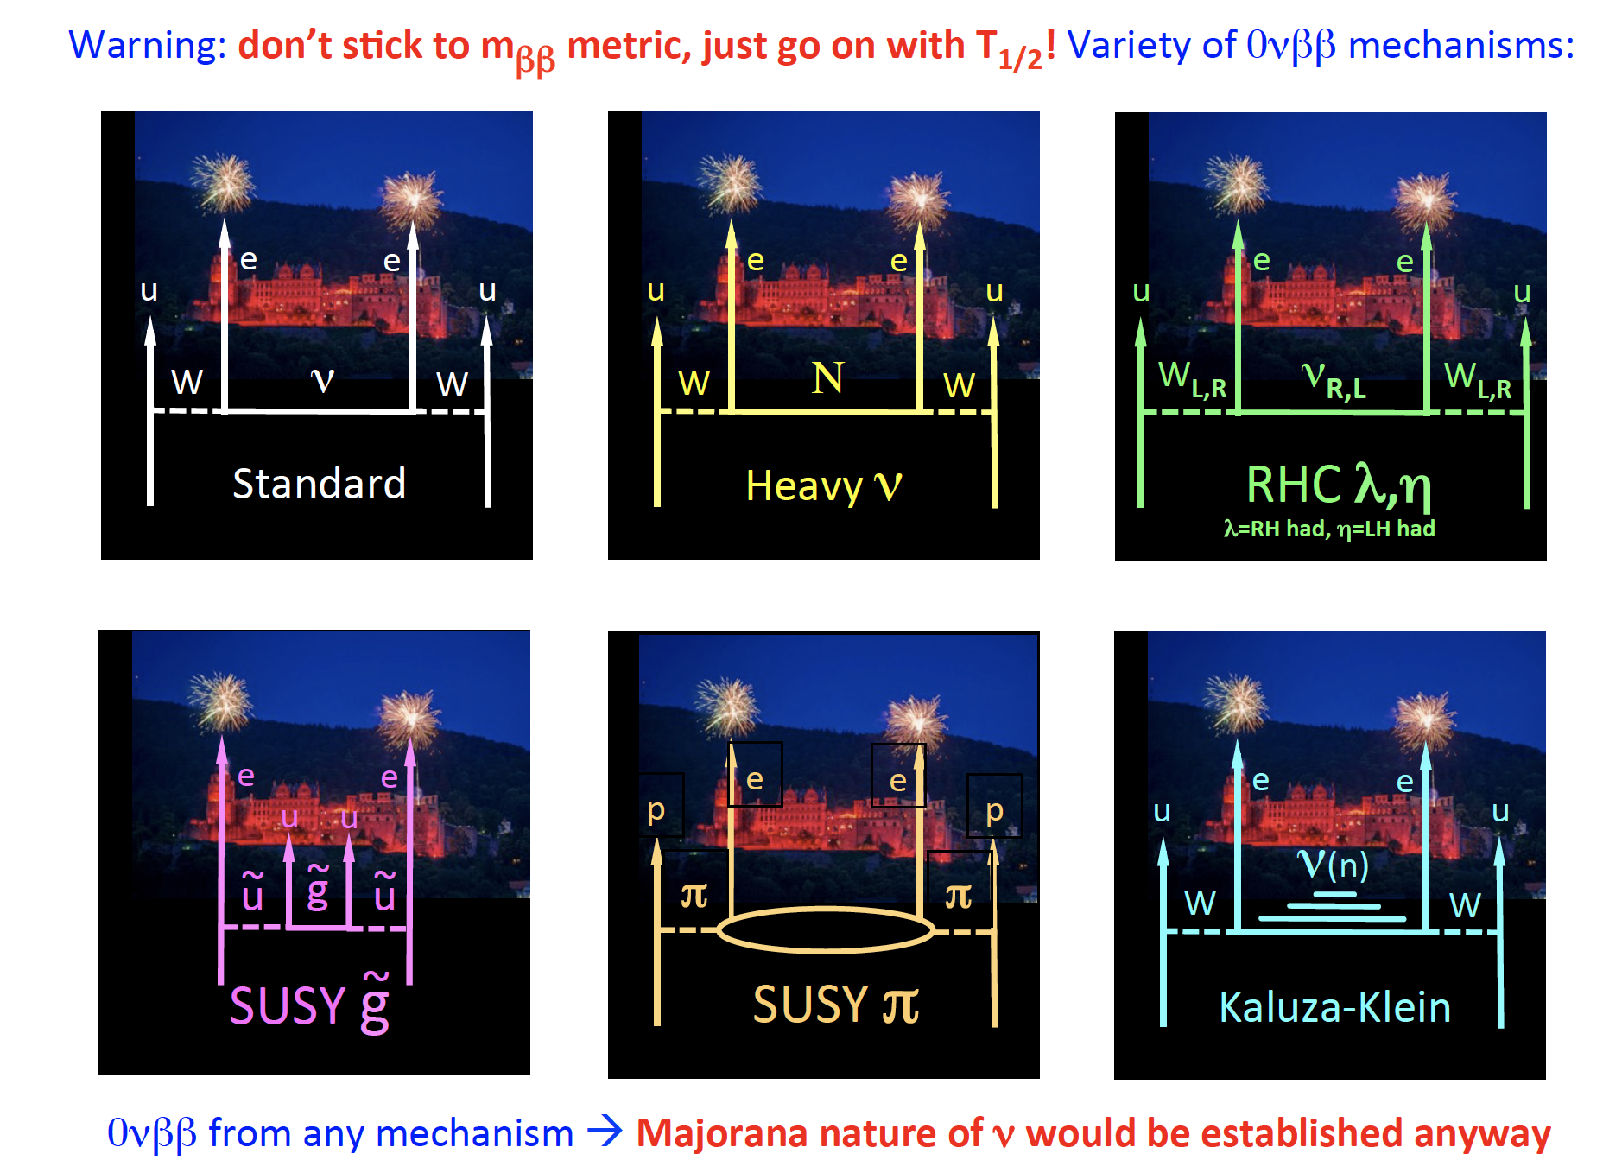
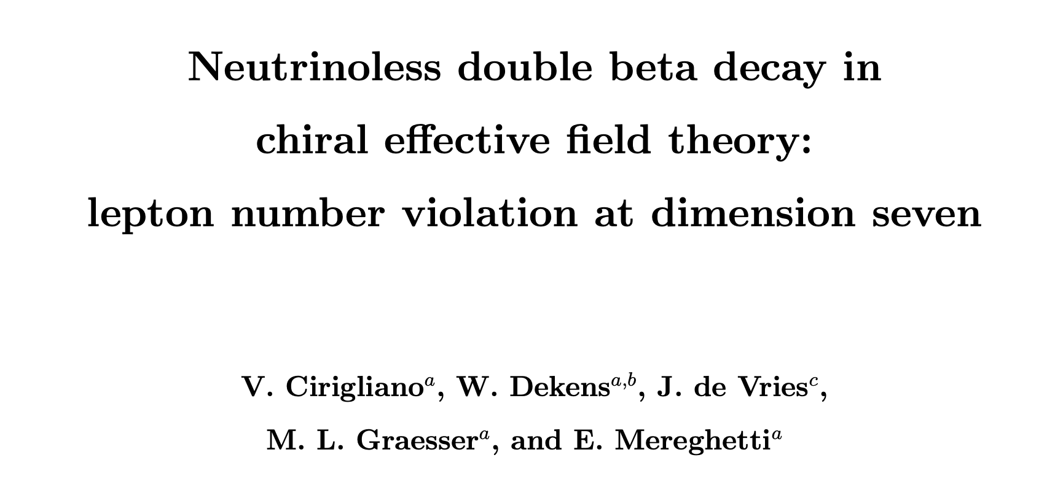
If SM is a low energy effective theory:
You can also get it from up here
https://arxiv.org/pdf/1708.09390.pdf
BSM theory with lepton number violation at high energy makes SM Wilson coefficients in the EFT expansion
So really we need to consider 0nubb as a discovery search – just hit the longest half lives possible!

Slide 36
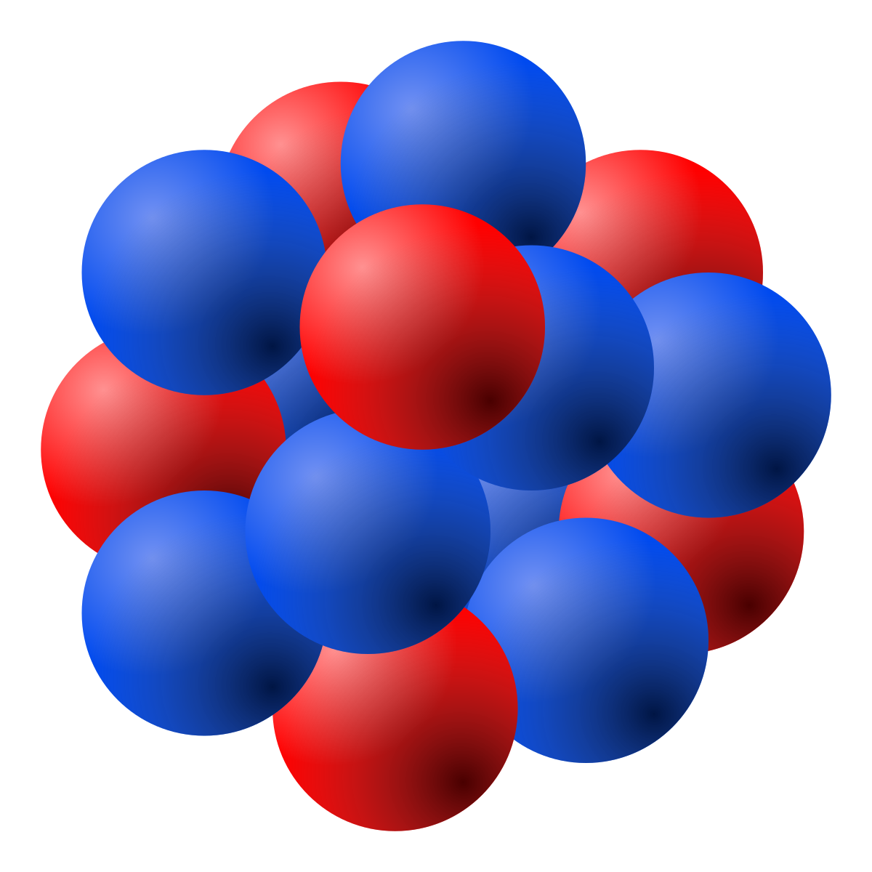
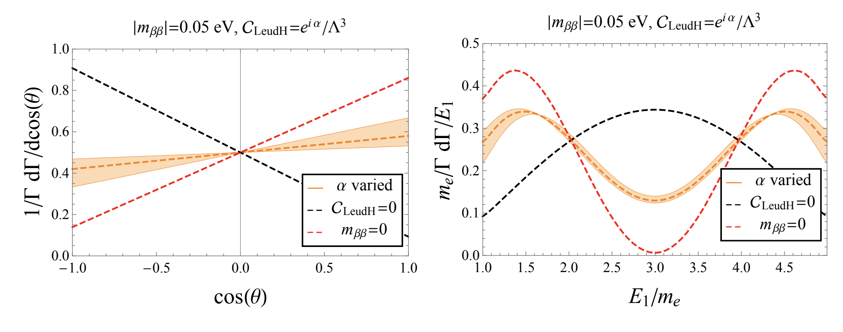
E₁
Given a high energy model, the kinematics of the final electrons can be predicted.
If 0nubb is seen, measuring the opening angle and energy sharing could illuminate the mechanism.
θ
E₂
Opening angle
Energy sharing

Slide 37



Current World heavyweight champion
WWE world heavyweight champion
Seth “Freakin” Rollins

Slide 38
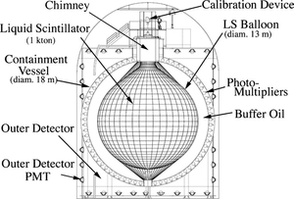
Current World heavyweight champion
WWE world heavyweight champion
0nubb world heavyweight chamption
Seth “Freakin” Rollins
Kamland “Freakin” Zen

Slide 39
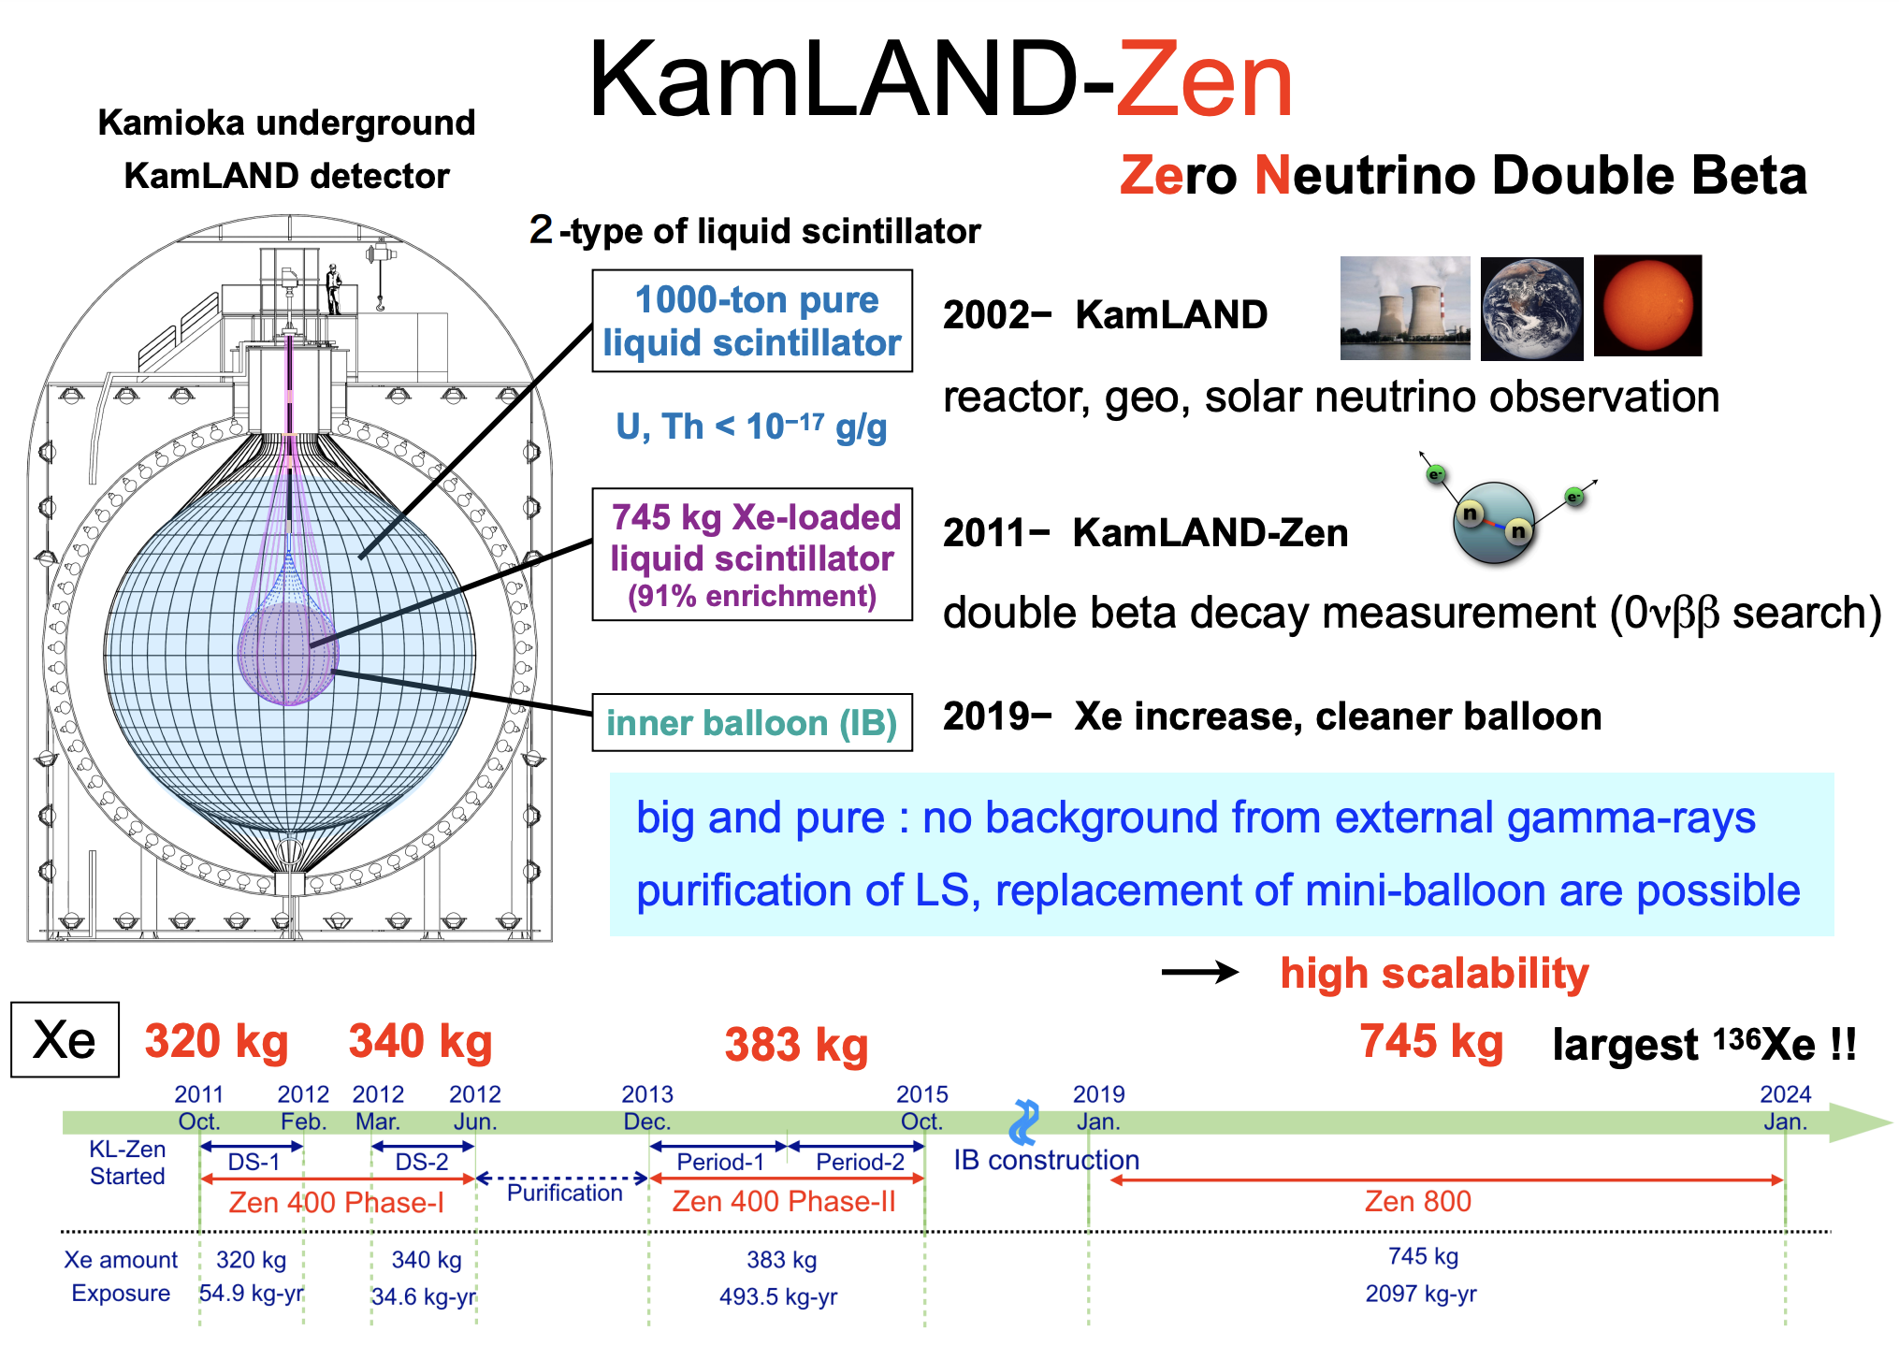
From Neutrino2024

Slide 40
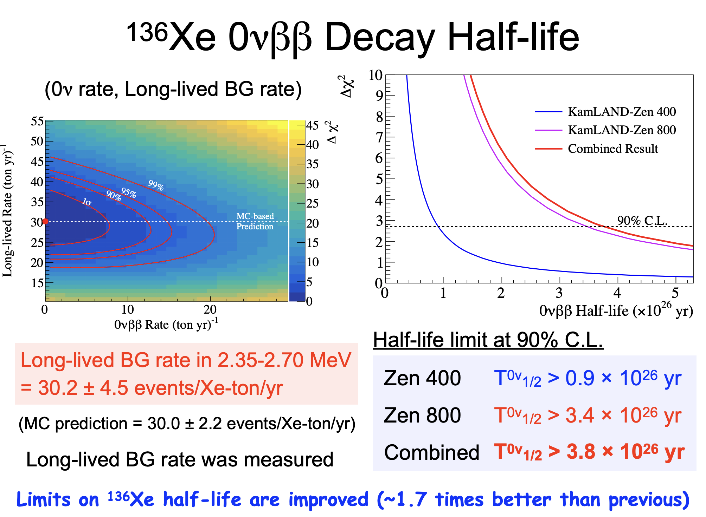
News from Neutrino2024:

Slide 41
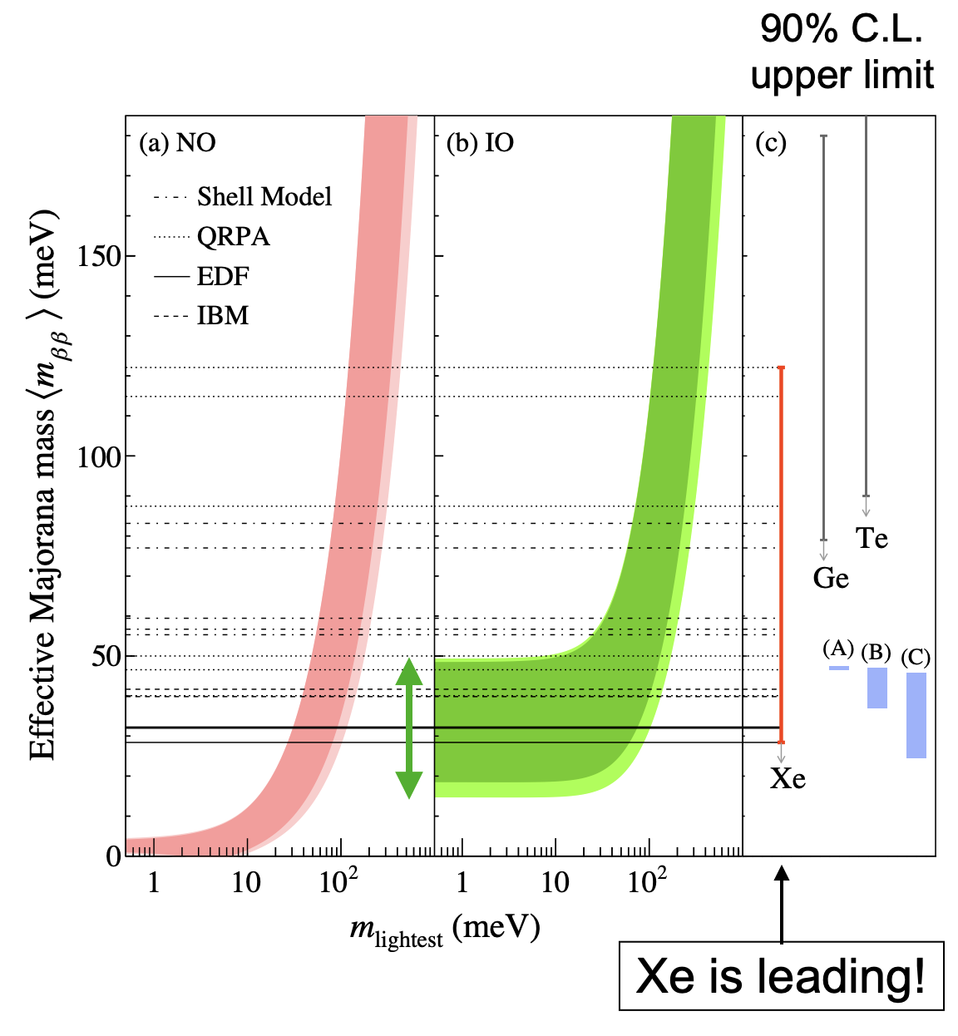
Current limits
KZ limit

Slide 42
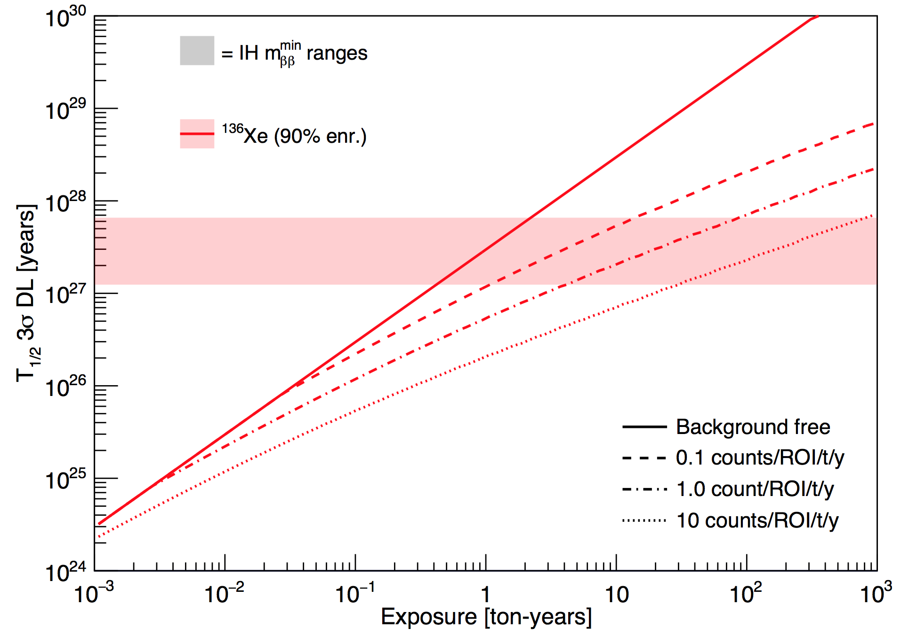
Going further:
Inverted Heirachy

Slide 43
Or to be specific:
Run for 2-3 years
Inverted Heirachy
Run for 15 years
Run for 100 years
Run for 1000 years
1000 kg experiment

Slide 44
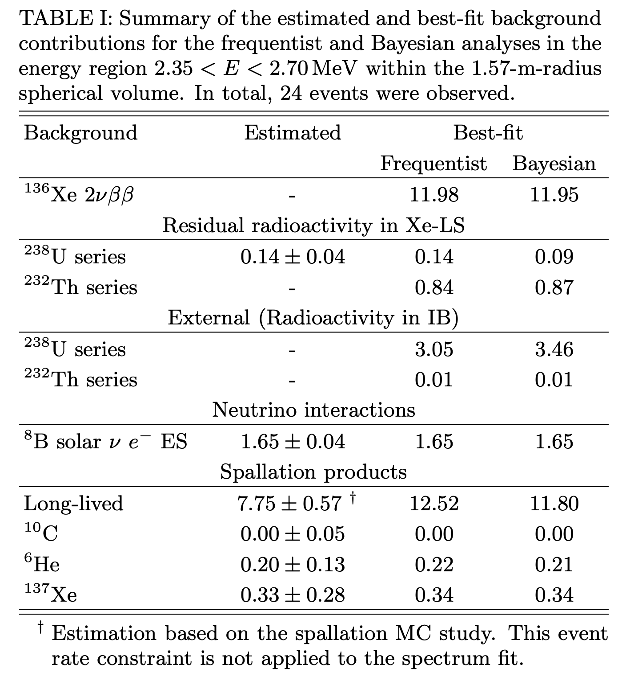
Where are the backgrounds from?
(nb: these are pre-Neutrino2024 numbers)

Slide 45
Where are the backgrounds from?

Slide 46
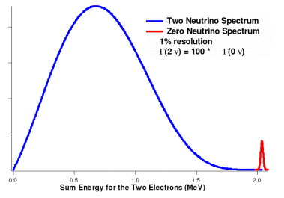
The ideal experiment:
MANDATORY:
  Resolution better than ~2% FWHM to fully reject two-neutrino mode
Then just watch and wait…

Slide 47
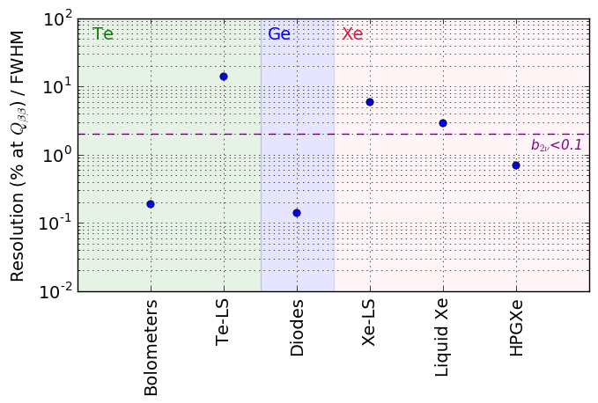
Measuring Energy
SNO+
KZ
EXO-200
NEXT-White
Free from 2nubb
CUORE
GERDA
Once free from 2nubb, radioactive and cosmogenic backgrounds become dominant

Slide 48
Measuring Energy
SNO+
KZ
EXO-200
NEXT-White
CUORE
GERDA
Solid state detectors are amazing for measuring energy.

Slide 49
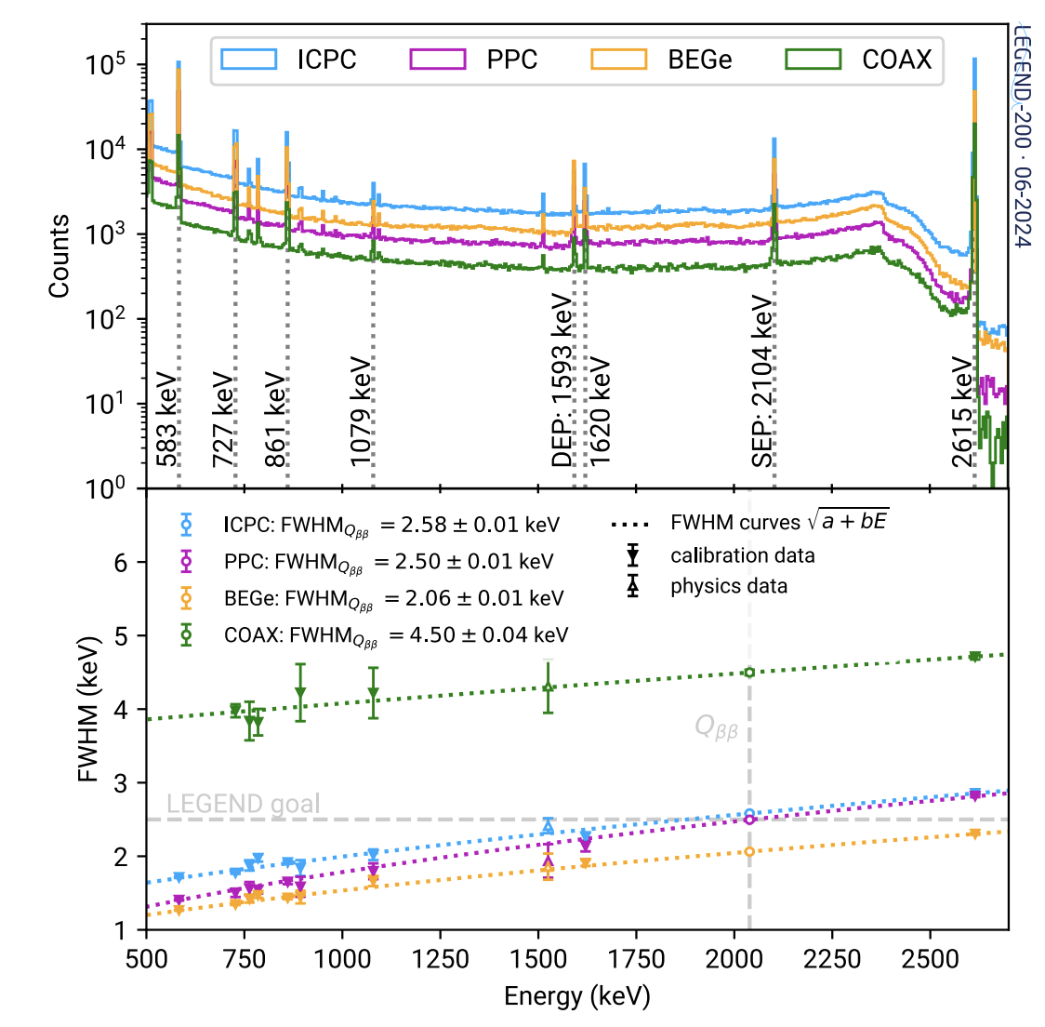
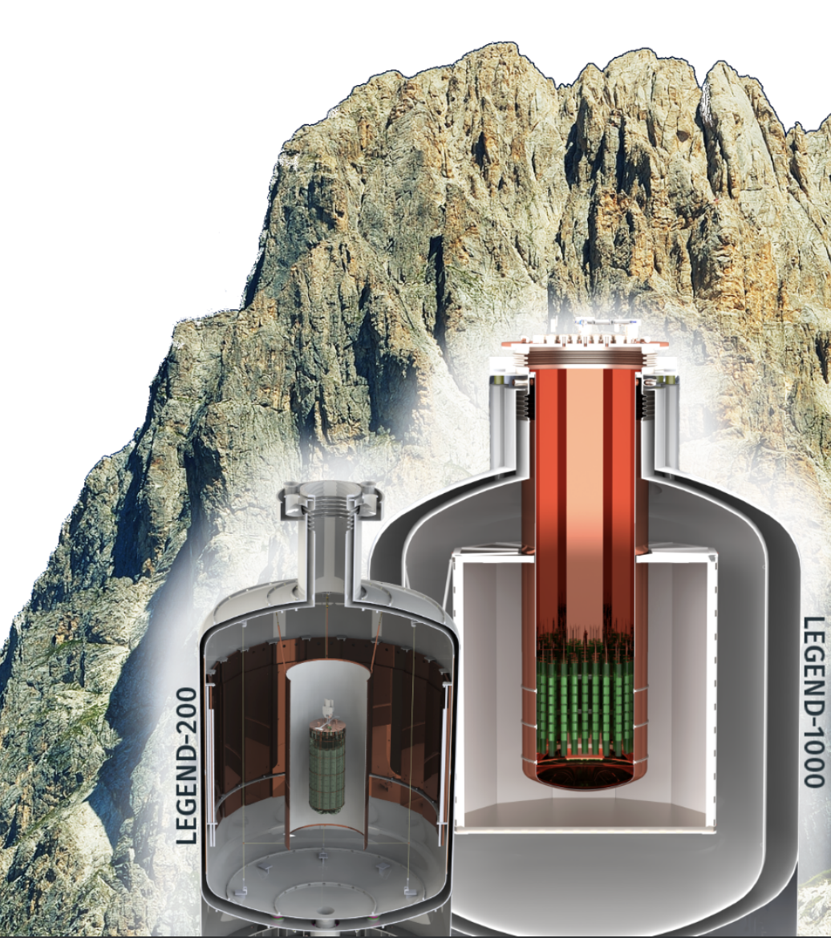
LEGEND
LEGEND200 backgrounds and energy resolutions:
200kg, eventually 1000kg, of enriched ⁷⁶Ge crystals
The king of excellent E resolution - 0.1%FWHM in the best crystals.
Notes:
Z

Slide 50
Measuring Energy
SNO+
KZ
EXO-200
NEXT-White
CUORE
GERDA
Xenon gas much better energy resolution than liquid Xe, why?

Slide 51
Recombination-limited ionization energy resolution
e⁻
+
+
+
Liquid
e⁻
+
+
e⁻
+
Recombination
Limited gas
Fluctuations in electron-ion recombination limit energy resolution for dense TPCs.
Every event is a random microscopic shape, so each loses different amounts of charge to recombination.
Intrinsic (up to ~50 bar)

Slide 52
Where are the backgrounds from?
Radiogenics
Solar neutrinos(!)
Cosmogenics
These will limit all future experiments.

Slide 53
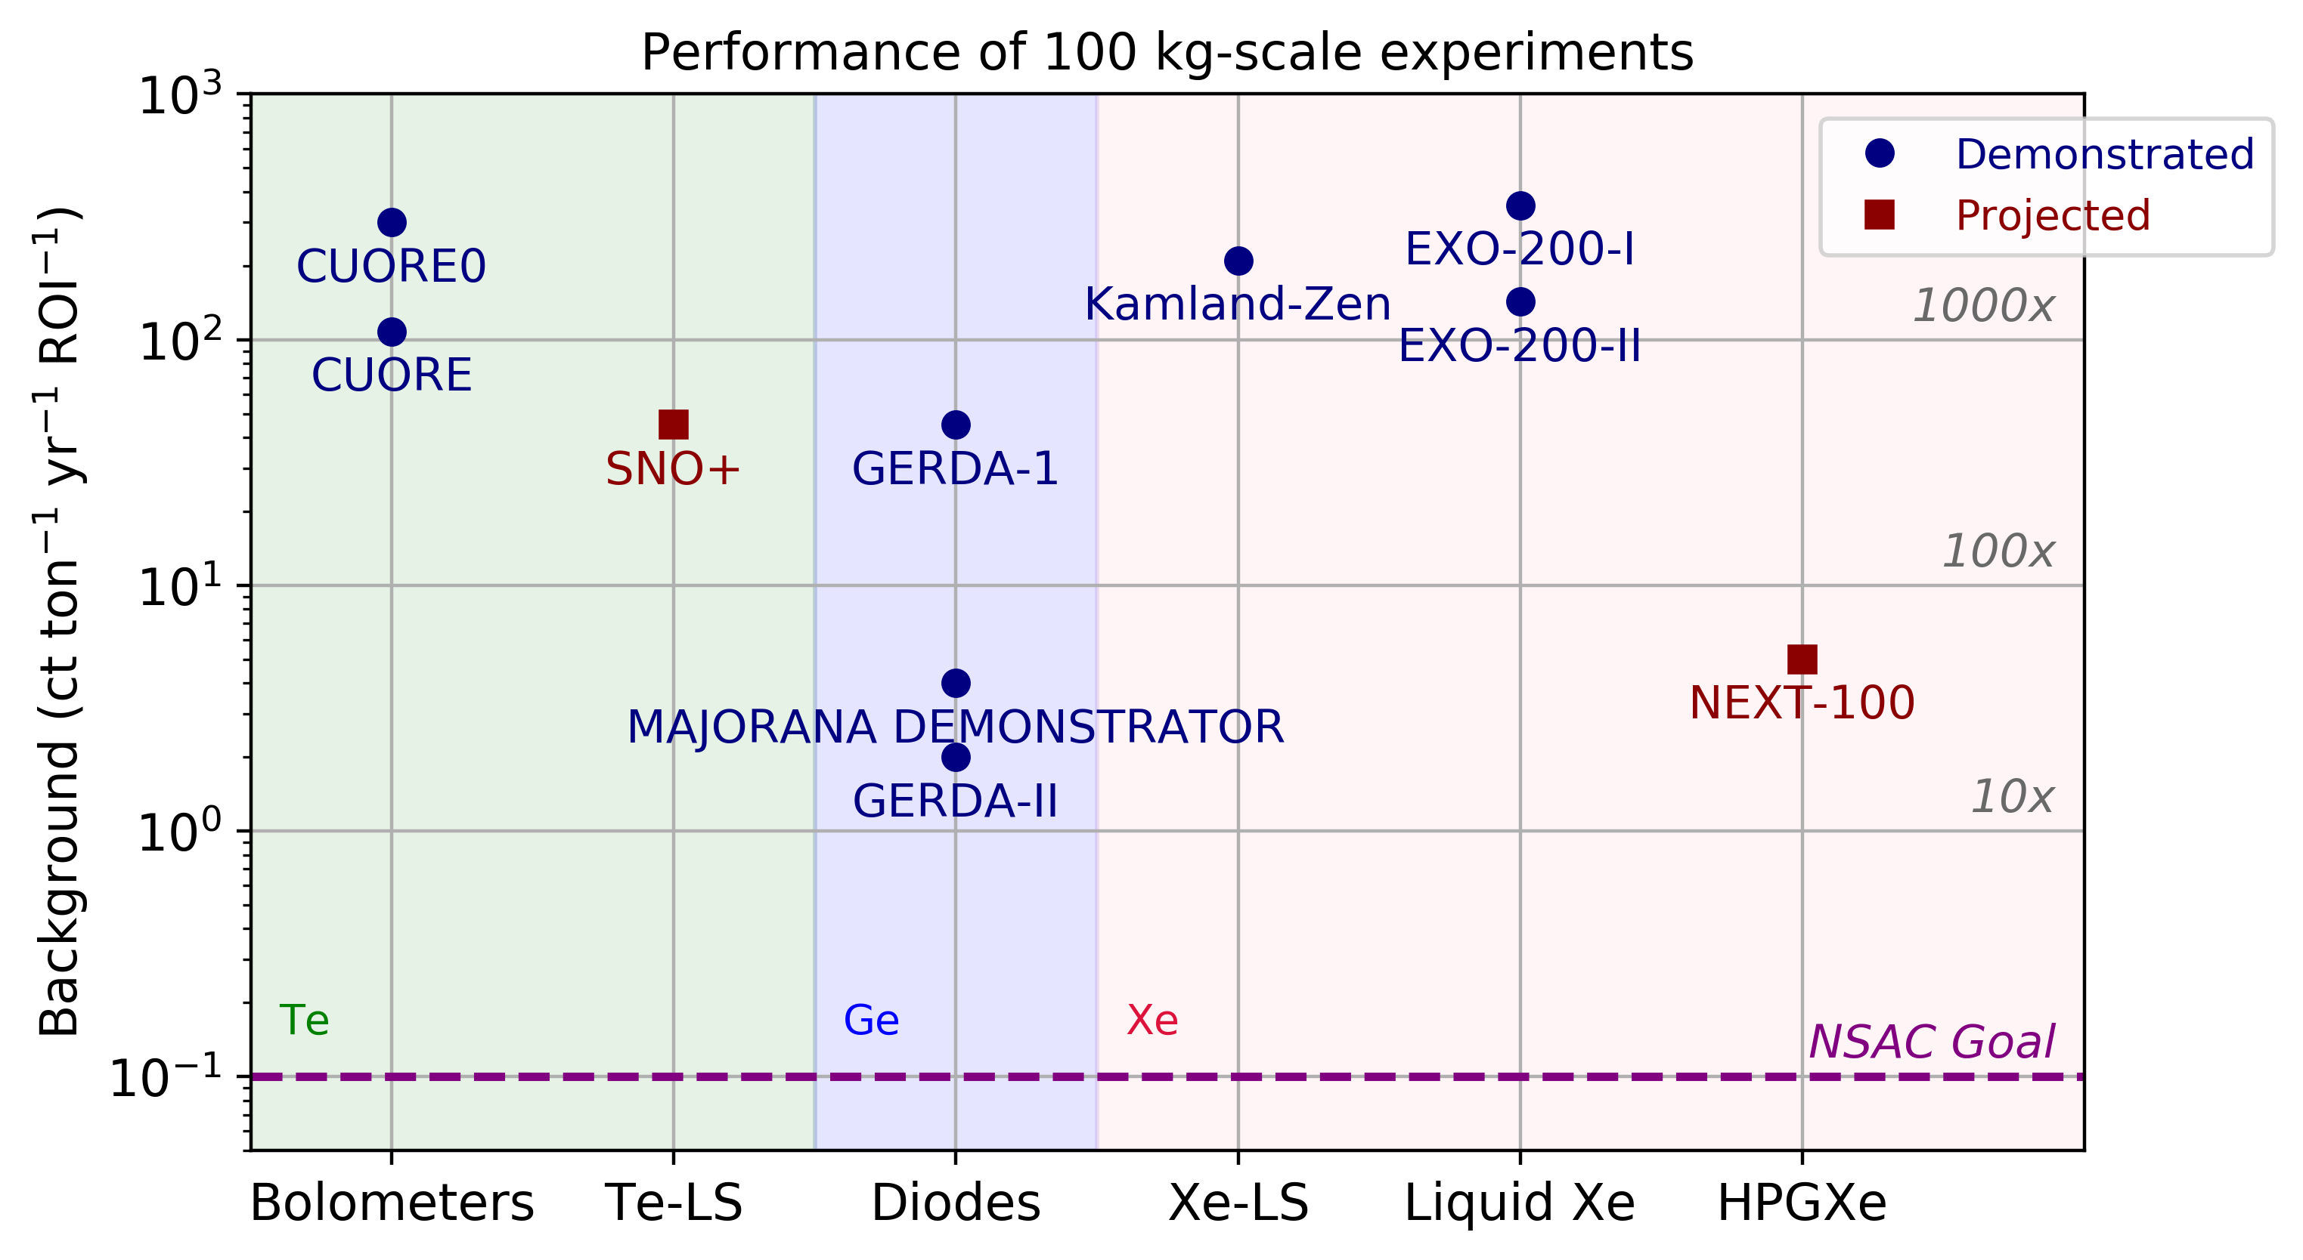
“100kg-class” experiments:

Slide 54
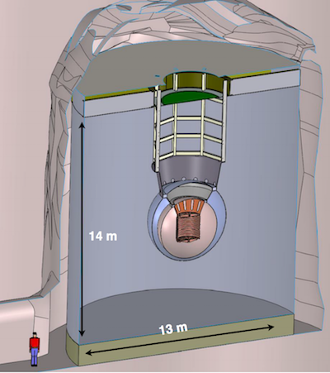
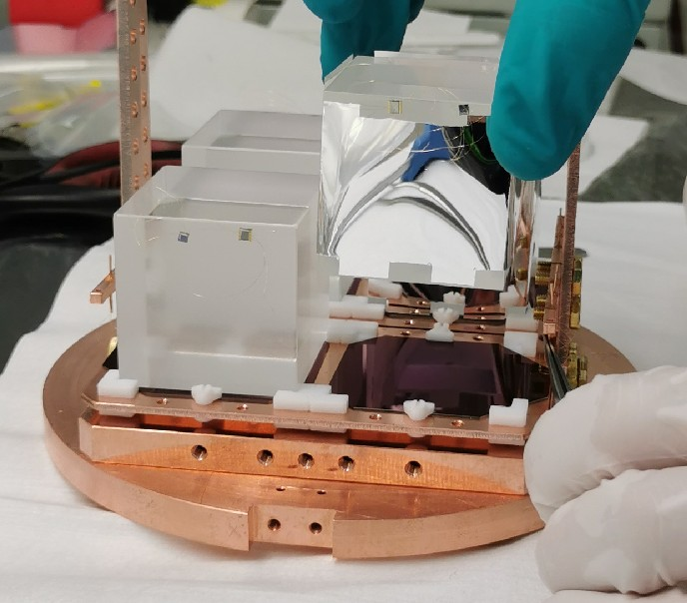
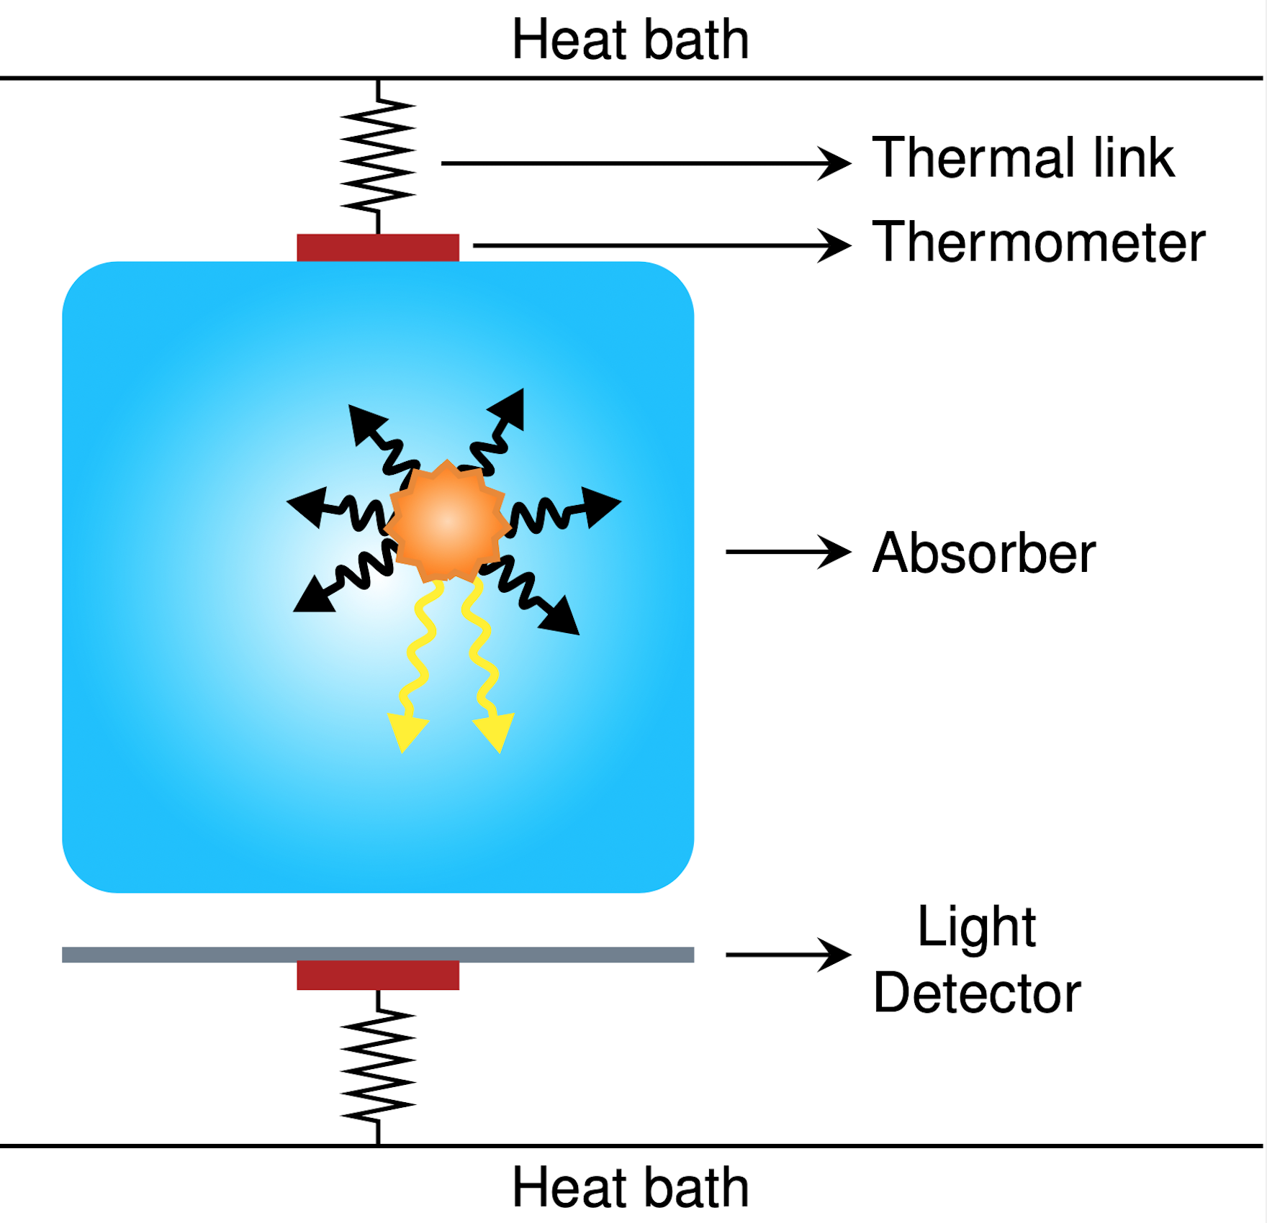
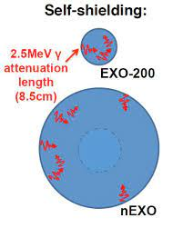
nEXO
CUPID
Proposed ton-scale liquid xenon detector.
Self-shielding of xenon from outer regions protects inner clean volume from backgrounds
Cryogenic bolometers coupled to light sensors
Precise calorimetry and optical handle on surface backgrounds advances on the CUORE approach.

Slide 55
“100kg-class” experiments:
I work on this one, so I’m going to tell you about it.

Slide 56

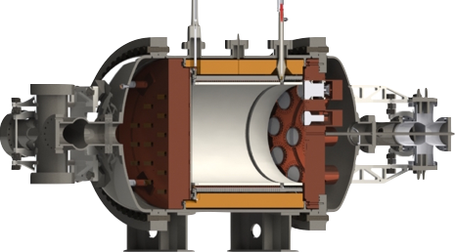
The NEXT Program
Sequence of HPGXe TPCs, focused on achieving big, very low background xenon 0νββ detector
→ NEXT-DBDM
→ NEXT-DEMO
→ NEXT-White
→ NEXT-100
N-Ton Scale
1800 SiPMs, 1cm pitch
HV Connections
10 kg active region (10bar) 50cm drift length
(Berkeley, US)
(Valencia, Spain)
(Canfranc, Spain)
(Canfranc, Spain)
SiPM feedthroughs
12 PMTs operating in vacuum (30% coverage)
R&D
NEXT-White operating now
Full underground technology demonstrator @10kg scale

Slide 57
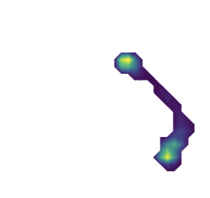
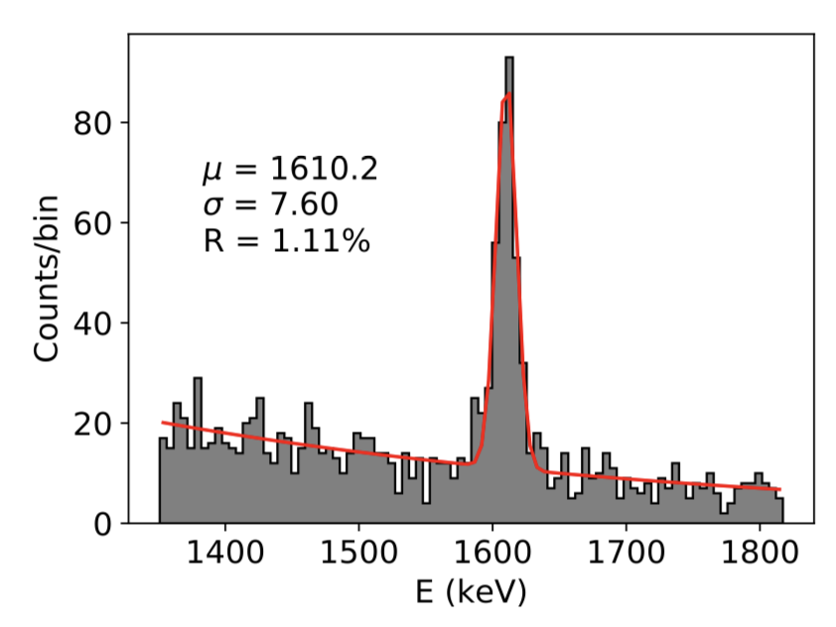
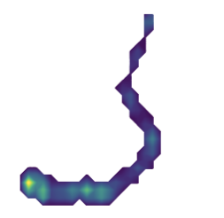
The 208Tl Double Escape Peak
NEXT-White data
SM process that makes e+e- at a well-defined energy.
We get to see energy resolution and topology all in one plot!
On double escape peak
15cm
208Tl double escape
NEXT-White data
→ 0.89% at Q_{bb}
15cm
Compton continuum
Off double escape peak
JHEP 2019, 52 (2019)

Slide 58



Two-neutrino double beta decay events
NEXT-White data
Topologically identified and away from double escape peaks

Slide 59

Barium tagging
¹³⁶Xe → ¹³⁶Ba + e + e
(My fave thing: forgive me for indulging ☺ )
Barium ion is only produced in a true ββ decay, not in any other radioactive event→
Identification of Ba ion plus ~1% FWHM energy measurement would give a background-free experiment.
Is it plausible to detect an individual barium ion or atom in a ton of material, inside a working xenon TPC?

Slide 60



Ba imaging in xenon ice
nEXO has developed methods of imaging Ba⁺ and Ba⁰ in carefully grown xenon ice.
Frozen Xe on cryo-probe
555nm
Various types of defect sites
Colors show bleaching effect
560nm
Single Ba²⁺ imaged in this site
Xe
Xe
Xe
Xe
Xe
Xe
Ba
Xe
Individual Ba atoms imaged in frozen xenon matrices in vacuum
564nm
Xe
Xe
Xe
Xe
Xe

Slide 61




Ba imaging in xenon gas
Xe
Xe
Xe
Xe
Ba²⁺
NEXT has built microscopy systems capable of imaging individual barium ions in high pressure xenon gas environments.
1mm x 1mm area can be scanned with single ion precision.
Xe
Xe
Xe
Ba²⁺
Individual Ba²⁺ ions imaged in 10 bar of xenon gas

Slide 62

TIRF
Single Ba²⁺ molecular complexes

Slide 63
The Ton Scale
Current limit
We need to do this with multiple isotopes and techniques
Ton Scale

Slide 64

1016.05 kg
1000.00 kg
907.19 kg
NB: if you use these tons, the sensitivity will be better.

Slide 65
Toward Normal Ordering
Current limit
Ton Scale
Beyond ton-scale
Can we ever do this?

Slide 66

Isotopes
Will need hundreds of tons of isotope. Current industrial production of any species is insufficient.
There are difficulties with both acquisition of raw material and its enrichment.
Some notable factoids:
  Tellurium:
  Comes naturally enriched to 34%. So natural tellurium is the most viable for an unenriched experiment.
  Molybdenum:
  New capacity for enrichment of Molybdenum in 100Mo for nuclear medicine is needed. 0nubb may be parasitic?
  Germanium:
  Semiconductor industry enriches germanium already; 76Ge can in principle be extracted as byproduct?
  Xenon:
  Atmospheric carbon capture technology based on metal organic frameworks has plausible extendibility to capture atmospheric Xe. Free from steel industry capacity limit?
Both enrichment R&D and new major facilities would be needed to produce isotope at the scale needed for a normal-ordering scale experiment.

Slide 67



Giant TPCs
Radiogenics become totally irrelevant due to self shielding
Cosmogenics and solar neutrinos become a serious concern!
If energy resolution achievable at scale, with kiloton masses, normal ordering parameter space is accessible.

Slide 68


Giant TPCs
…in salt caverns?
Radiogenics become totally irrelevant due to self shielding
Cosmogenics and solar neutrinos become a serious concern!
If energy resolution achievable at scale, with kiloton masses, normal ordering parameter space is accessible.

Slide 69



Isotope in kTons of liquid scintillator…
Xe or Te loaded in kilotons of liquid scintillator→

Slide 70



Isotope in kTons of liquid scintillator…
Much, much R&D…
Xe or Te loaded in kilotons of liquid scintillator→
Quantum dot doped liquid scintillator @NuDot
Dichroicon
Slow scintillator for Cerenkov separation

Slide 71



Isotope in kTons LS, or in liquid argon?
Achieving this energy resolution in DUNE is an extreme challenge.
Xe or Te loaded in kilotons of liquid scintillator→
Argon also needs to be depleted to remove background from 42Ar →

Slide 72
Conclusions
NDBD is the only sensitive known way to probe the Majorana nature of the neutrino.
Experiments at the 100kg scale have demonstrated background indices in the range 2-200 ct/ton/ky/yr
Ton-scale experiments plan to reduce backgrounds by 1.5-3 orders of magnitude relative 100kg phases and probe the inverted mass ordering range of parameter space.
Beyond-ton-scale will require huge, ultra-low background detectors that we don’t yet know how to build, but need to figure out!

